Slide 1
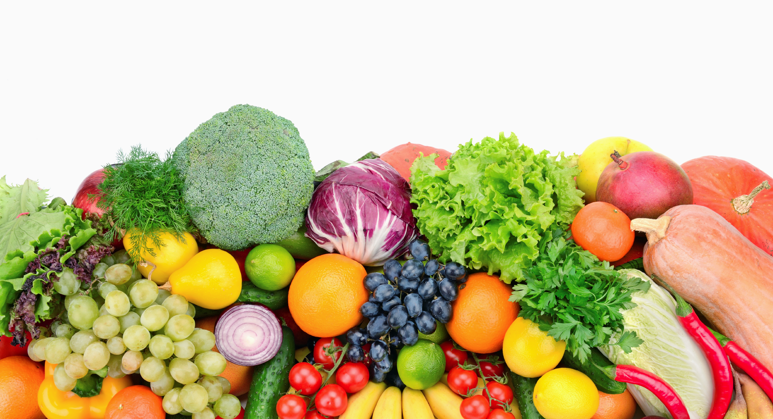
Group 9: Diet Planning Project
SCM702 Final Project
Qingqing Hu
Zhiwei Wang
Nan Zhang

Slide 2
Part I
Project Overview

Slide 3
The problem: dietary planning
How an individual makes food purchase in order to satisfy his/her daily nutrition needs
Within the budget
Diversity
Why worth studying?
Time-saving
Significance of adequate nutritional intake
Policy-making
Applicable in similar scenarios:
a food service manager in an institution planning daily menus;
a government agency planning large nutrition or food assistance programs

Slide 4
Why do we choose LP model?
Total nutrition can expressed as a linear function of food.
The contribution of each food to the nutrition is proportional to its weight. If you eat 200g apple, the nutrition you get is as twice as 100g apple.
The contribution to the nutrition for any food is independent of the other food. When you eat 100g apple and 100g bread, you can get all the nutrition of those. Bread does not impair the nutrition you can get from apple.
All the constraints are also linear function of the food.
To make it more practical, we set minimum and maximum weight for each kind of food we choose.
We have dummy variable y to show whether the food is chosen. We can use y to set constraints for the kinds of food chosen. It also helps us to meet the requirement of minimum and maximum.

Slide 5
Q:
Do we need to eat much every day to reach nutrition requirements?
Expensive or not?

Slide 6
Part II
Model and Analysis

Slide 7
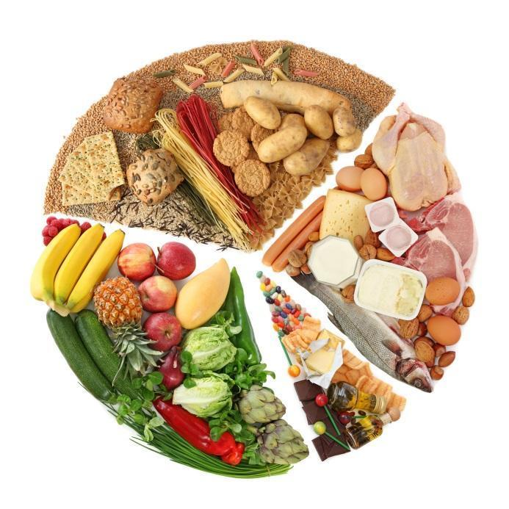
Variables and function
Decision Variables: what item to choose & amount of each item
14 items of food:
X1 = amount of white bread
X2 = amount of whole-wheat bread
…
X14 = amount of Gala apple
yi=Dummy variable(i=1,2….14)
Objective Function: linear model
Target: to minimize the cost
Z = 0.88 * X1 *+ 0.99 * X2 +….0.89 * X14
Sum of price times amount

Slide 8
Constrains
Daily nutrition constraints( for adults)
Calories >= 2000kcal
Protein >= 50g
Fat <= 70g
Carb >= 260g
(Reference intakes from the report on NHS)
Diversity constraints
Amount of each item >= 80g
Maximum amount for each type of food
Bread (400g)
Meat & Egg (500g)
Vegetable (500g)
Fruit (350g）
Minimum requirement for each type of food
at least 1 kind of bread
at least 2 kinds of meat or egg
at least 2 kinds of vegetable
at least 2 kinds of fruit

Slide 9
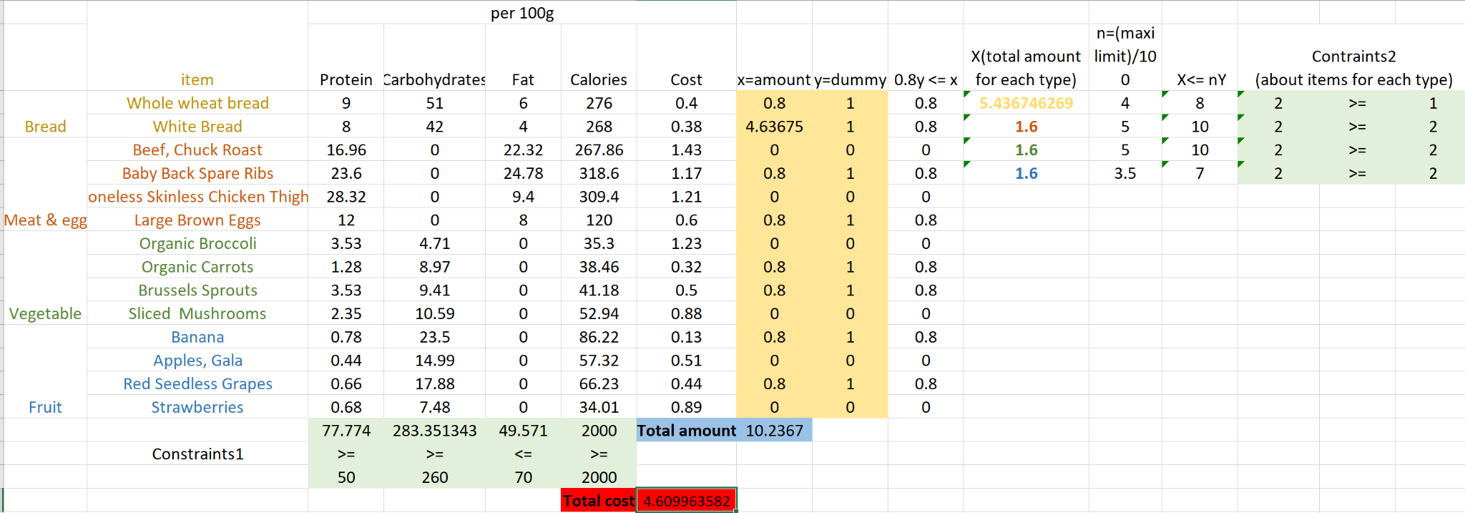
Optimal Solution
Bread: wheat bread(80g), white bread(463.67g)
Meat & Egg: ribs(80g), egg(80g)
Vegetable: sprouts(80g), mushrooms(80g)
Fruit: banana(80g), grapes(80g)
minimum cost: $4.61---not expensive
total amount:1023.68g---not much

Slide 10
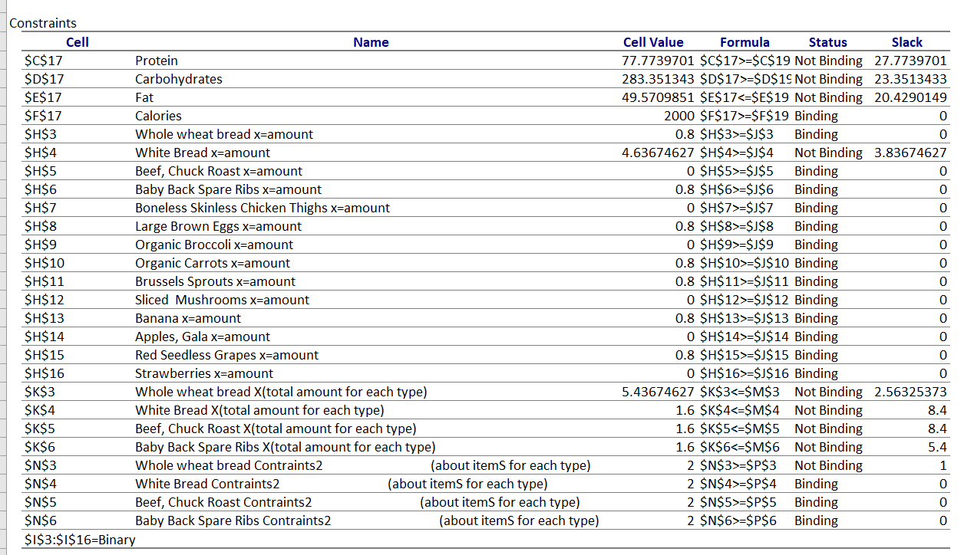
Answer Report
Binding constraint:
a equality constraint or a constraint that has been pushed to its upper or lower bounds. (E.g. Calories...)
Not Binding:
a constraint that is not at the imposed upper or lower bound. (E.g.Protein...)

Slide 11
Part III
Insights & Issues

Slide 12
insights
Among carb, protein, fat, and calories, only calories is ‘binding’ in the function
If we only consider carb, protein, fat, and energy:
White bread is the most eco-friendly food that can satisfy basic nutritional needs
Other food chose by solver is just the same amount as the minimum constraint.
Cost is around $5/day---cheap
Interesting facts:
the optimal solution for two kinds of bread
the optimal solution for item(dummy=1) is the lower limit

Slide 13
Issues
Nutritional requirement not comprehensive: lack of vitamin & dietary fiber
Food choices in real world scenario: more than 14 types
Personal taste
Market price
Seasonality
Popularity( for adults)
Implementing issue: what if number of egg for 100g is not an integer ; intake the exact weight for food
Not scalable for weekly planning,

Slide 14
Thanks you!

Slide 15
Work-cited:
https://www.nhs.uk/live-well/eat-well/what-are-reference-intakes-on-food-labels/
https://www.cbsnews.com/news/for-a-longer-life-researchers-say-eat-this-many-fruits-and-veggies-per-day/
https://www.wegmans.com/

